Slide 1
Welcome
To my Presentation

Slide 2

Exploring Paracetamol Pharmaceutical Production
Submitted To | Submitted By
Dr. Halima Begum Assistant Professor Department of Chemistry University of Barishal. | Mohammad Rabiul Islam Department of Chemistry University Of Barishal

Slide 3
History of the company:
SQUARE Pharmaceuticals Limited is a Bangladeshi multinational pharmaceutical company. It is the largest pharmaceutical company in Bangladesh and it has been continuously in the 1st position among all national and multinational companies since 1985. It was founded in 1958 by Samson H. Chowdhury along with three of his friends PK Saha, Kazi Harunur Roshid and Radhabinod Rai as a private firm. It went public in 1991 and is listed on the Dhaka Stock Exchange and on the Chittagong Stock Exchange .Square Pharmaceutical started to export different antibiotics and medicine across the world from 1987. Now it exports its medicine to 36 countries of the world.
In 2008 and 2009 it had the highest market share in the pharmaceutical industry of Bangladesh. For the last couple of years, it has been seeing double digit revenue every year. the Forbes list said Square Pharmaceutical Company of Bangladesh, involved in drug and chemical business, has sales volume worth $512 million. The local pharma's market capital is $1.7 billion. Its net income is $150 million and has employed 9,240 people.

Slide 4
Introduction:
The word “Pharmacy” is the combination of the Greek term “pharmakon” (magic, charm, cure, potion, medicine) and the Latin term “pharmacie”. Pharmacy is the science and practice of discovering, producing, preparing, dispensing, reviewing and monitoring medications, aiming to ensure the safe, effective, and affordable use of medicines. It is a miscellaneous science as it links health sciences with pharmaceutical sciences and natural sciences. The professional practice is becoming more clinically oriented as most of the drugs are now manufactured by pharmaceutical industries.
Paracetamol (or acetaminophen) is a common analgesic, a drug that is used to relieve pain. It can also be used to reduce fever, and some kinds of headache. This makes it an antipyretic, something that reduces fevers. It is used in many drugs that treat the flu and colds. The words acetaminophen and paracetamol both come from the names of the chemicals used in the compound: N-acetyl-para-aminophenol and para-acetyl-amino-phenol. Sometimes, it is shortened to APAP, for N-acetyl-para-aminophenol. Paracetamol (acetaminophen) is undoubtedly one of the most widely used drugs worldwide. As an over-the-counter medication, paracetamol is the standard and first-line treatment for fever and acute pain and is believed to remain so for many years to come. Despite being in clinical use for over a century, the precise mechanism of action of this familiar drug remains a mystery.

Slide 5
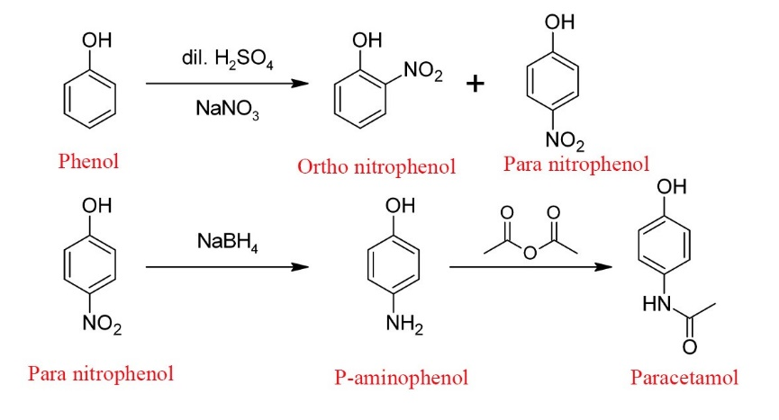
Synthesis of Paracetamol:
Chemical Formula: C₈H₉NO₂
Melting point: 169 °C
Boiling point: 420 °C
IUPAC ID: N-(4-hydroxyphenyl)acetamide, N-(4-hydroxyphenyl)ethanamide
Soluble in: Water, Acetone.

Slide 6
Thank You

